Slide 1
RL Novels
Dynamic Programming
Giovanni GATTI PINHEIRO
July, 23rd 2019
AIR-REV-DPI-MLS
Notes:
Cover example with no photo
To update the text, just click on the text
To get more slides with this layout just copy this slide and paste

Slide 2
What is this group about?
Let’s get things clear from the start!
RL is everywhere in Internet:
Textbook is quite good (and it is available online and at the Amadeus library): http://incompleteideas.net/book/RLbook2018.pdf
David Silver’s RL course: http://www0.cs.ucl.ac.uk/staff/d.silver/web/Teaching.html
Excellent online materials: https://github.com/dennybritz/reinforcement-learning
Why Yet Another RL course (study group)?
I need feedback!
This is supposed to be a group for non-expert (me) to non-experts

Slide 3
Agenda
Markov chains
Markov Decision Process
Bellman optimality equation
Policy evaluation
Policy improvement
Policy iteration algorithm
Value iteration algorithm
DP drawbacks
Basic notions
Dynamic Programming

Slide 4
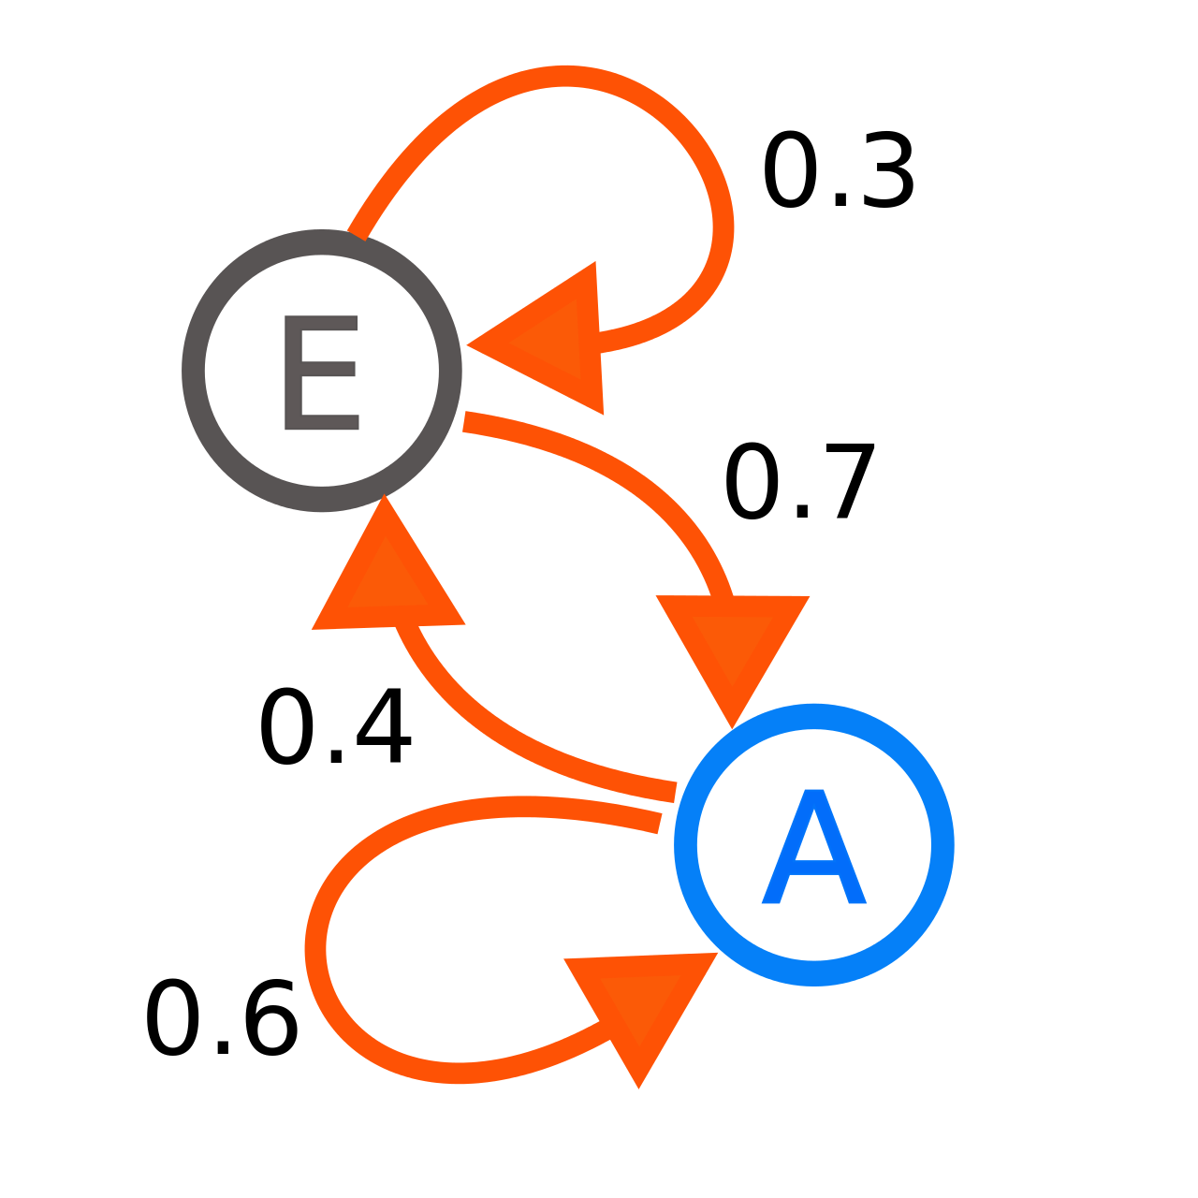
Quick overview
Markov chains
A Markov chain is a stochastic model describing a sequence of possible events in which the probability of each event depends only on the state attained in the previous event
p(s’ = E | s = A) = 0.4
Discrete state space or
Discrete index set (often representing time)

Slide 5






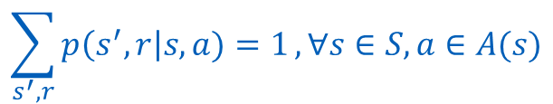


Quick overview
Markov Decision Process
$$p\left(s^{′}=S_{1}, r=R_{0} \right| s=S_{0}, a=A_{1})$$
Markov chains: +actions +rewards
$$R_{0}$$
S₁
A₁
$$R_{1}$$
$$p\left(s^{′}=S_{1}, r=R_{1} \right| s=S_{0}, a=A_{1})$$
$$R_{2}$$
$$p\left(s^{′}=S_{2}, r=R_{2} \right| s=S_{0}, a=A_{1})$$
S₀
S₂
$$R_{3}$$
A₂
$$R_{4}$$
S₂
$$\sum_{s^{′}, r}{p\left(s^{′},r\right|s,a)=1}, ∀s∈S, a∈A(s)$$

Slide 6
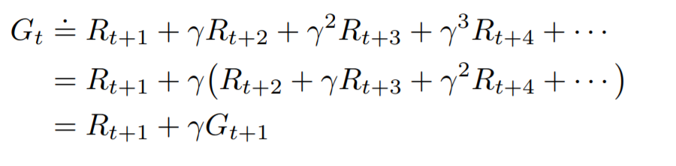
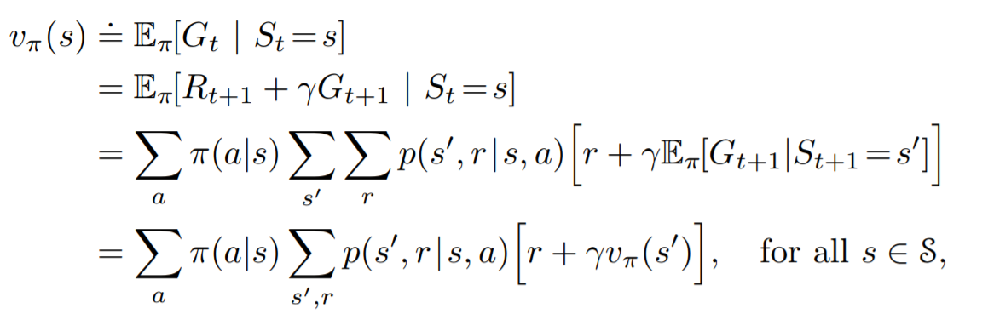


Quick overview
Policies and Value Function
How good it is for the agent to be in a particular state?
_{s'}
Total Return:
p
a
r
$π(a|s)$ : policy -> probability of taking action a given state s
_{s}
R
+1
$$π\left(a=R | s\right)=.9$$
-1
$$π\left(a=L | s\right)=.1$$
L
Bellman eq.

Slide 7
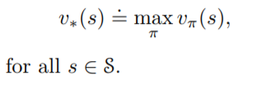
How can we find the optimal behavior ?
But, what optimal means?
Notes:
Solving a reinforcement learning task means, roughly, finding a policy that achieves a lot of reward over the long run.
There is always at least one policy that is better than or equal to all other policies. This is an optimal policy. Although there may be more than one, we denote all the optimal policies by pi_*

Slide 8
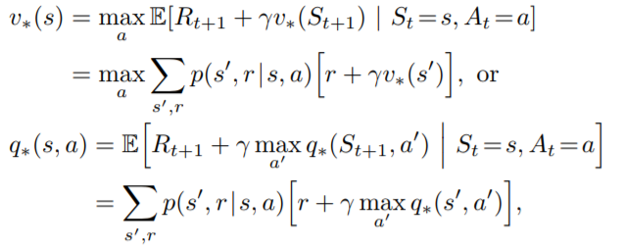

Dynamic Programming
Bellman Optimality equations
Let $v_{∗}(s)$ and $q_{∗}\left(s,a\right)$denote the optimal value functions
_{s'}
p
a
r
_{s}

Slide 9
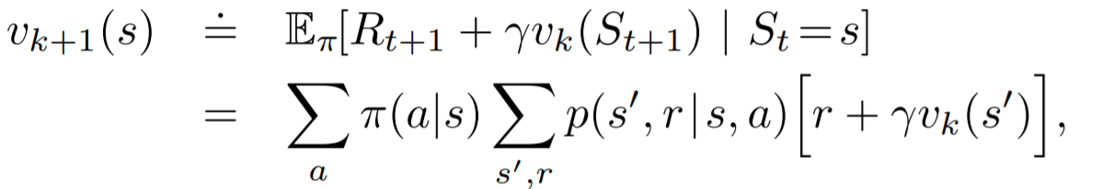
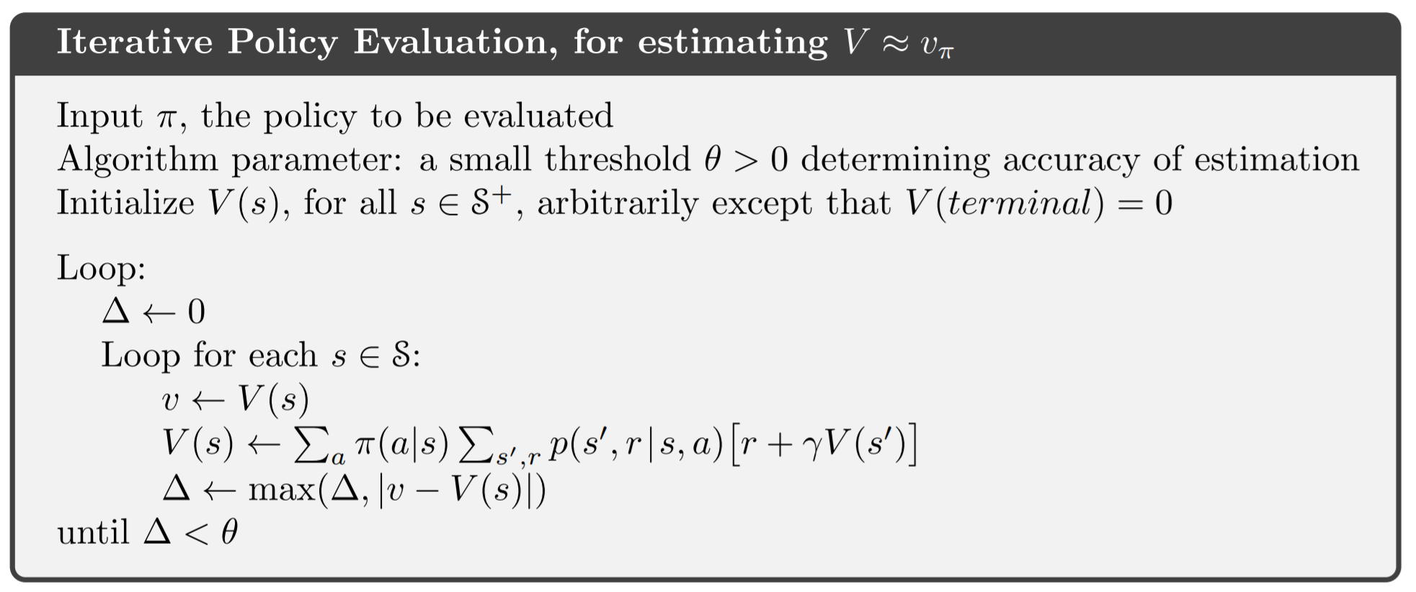
Dynamic Programming
Policy evaluation (Prediction Problem)

Slide 10
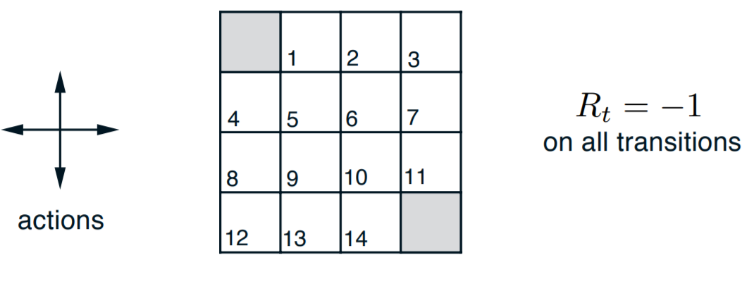
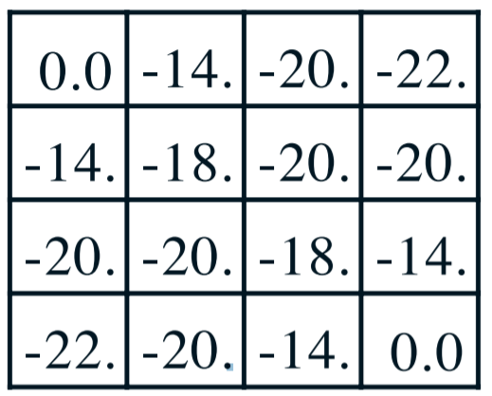

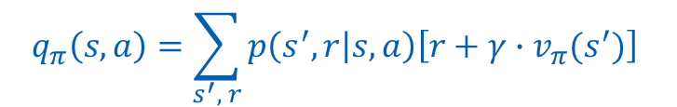




Dynamic Programming
Policy evaluation (Prediction Problem)
$$π\left(N | s\right)=π\left(S | s\right)=π\left(E | s\right)=π\left(W | s\right)=0.25, ∀s$$
$$γ=1$$
$$q_{π}\left(s, a\right)=\sum_{s^{′}, r}{p\left(s^{′}, r | s, a\right)\left[r+γ∙v_{π}(s^{′})\right]}$$
Bootstrapping!
$q_{π}\left(S_{11}, South\right)=$ ?
$$=1 ∙\left[−1+1∙0\right]=−1$$
$$q_{π}\left(S_{7}, South\right)= ?$$
$$=1 ∙\left[−1+1∙(−14)\right]=−15$$

Slide 11
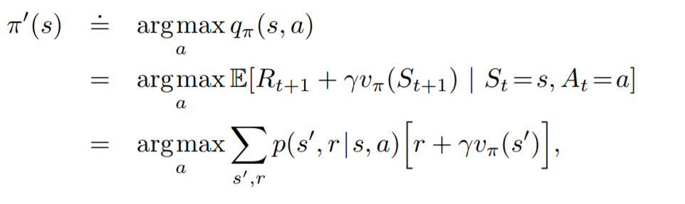
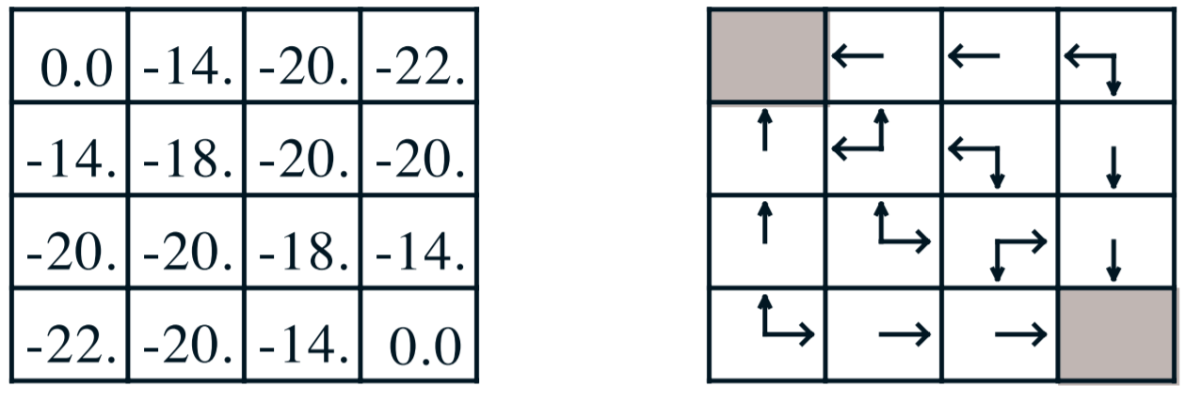
Dynamic Programming
Policy improvement
We have a policy, we know how to evaluate it. How can we find a better policy? (act greedy using the value function from previous policy)
See Policy Improvement Theorem (pg. 78 from textbook)

Slide 12
How can we find the optimal policy ?
Notes:
Solving a reinforcement learning task means, roughly, finding a policy that achieves a lot of reward over the long run.
There is always at least one policy that is better than or equal to all other policies. This is an optimal policy. Although there may be more than one, we denote all the optimal policies by pi_*

Slide 13
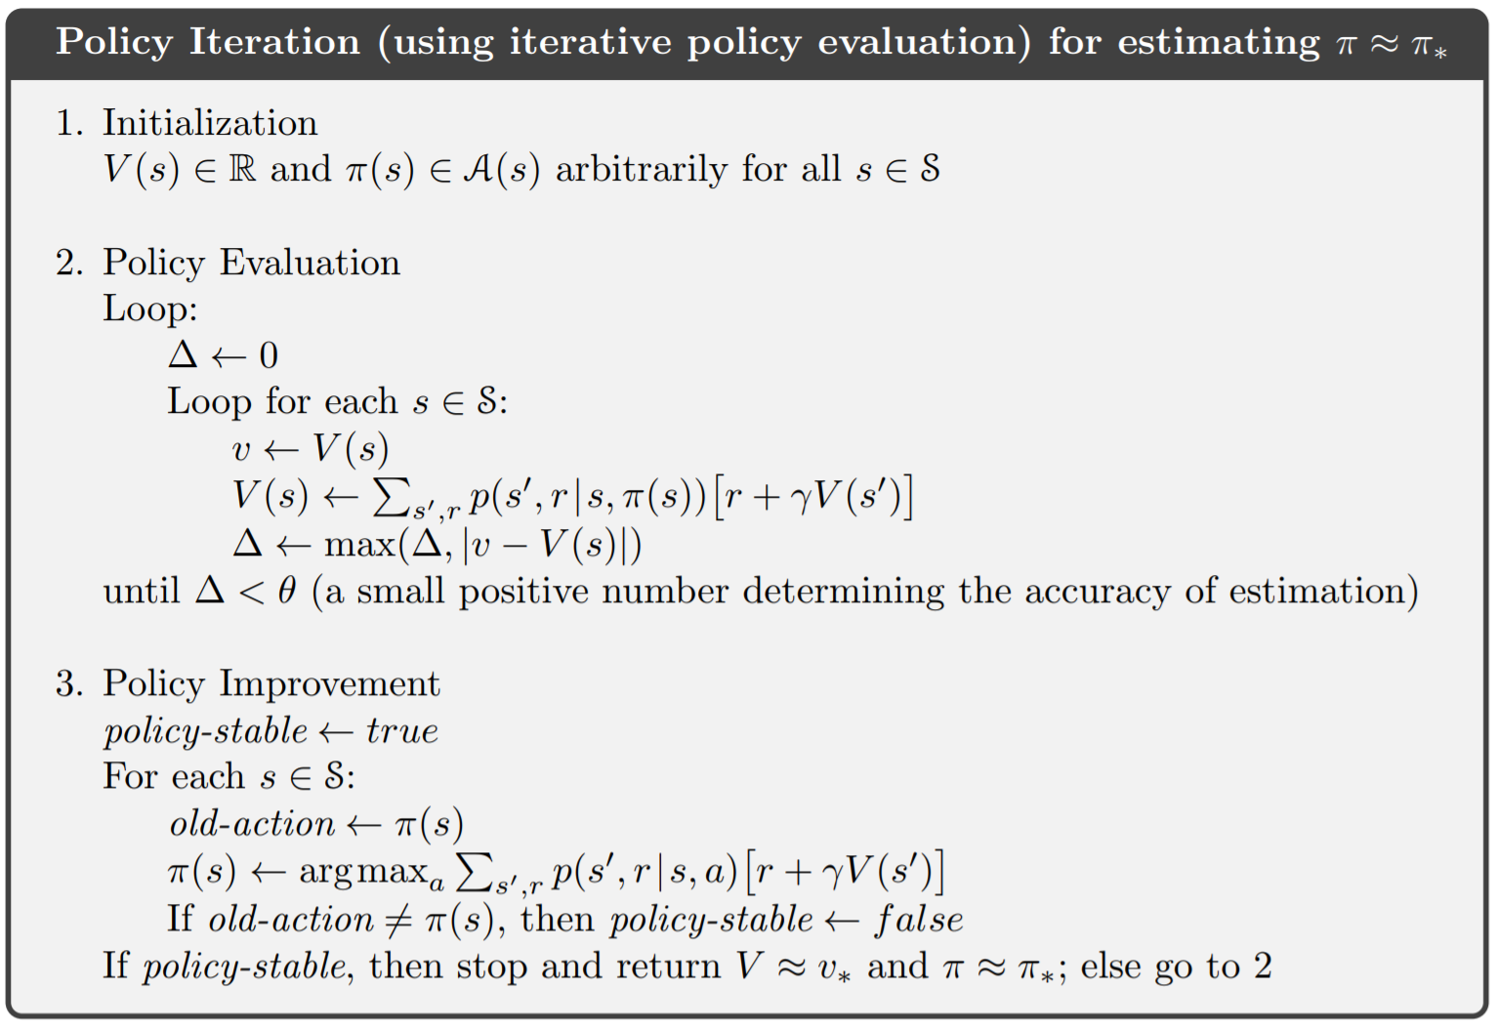

Dynamic Programming
Policy Iteration Algorithm
https://cs.stanford.edu/people/karpathy/reinforcejs/gridworld_dp.html

Slide 14
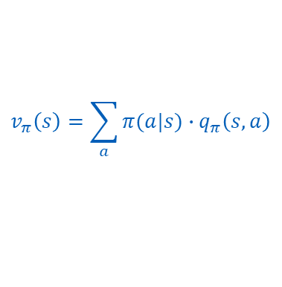


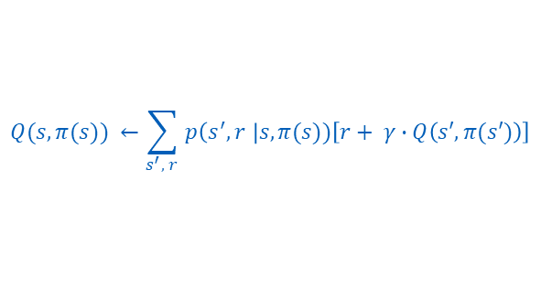


Dynamic Programming
Hint:
$$v_{π}\left(s\right)=\sum_{a}{π(a|s)∙q_{π}\left(s,a\right)}$$
Policy Iteration Algorithm
Can we modify this algorithm to use q instead?
$$Q(s,a)$$
$$q←Q\left(s,a\right)$$
$$Q(s,π(s)) ←\sum_{s^{′}, r }{p\left(s^{′}, r \right|s,π(s))\left[r+ γ∙Q\left(s′,π(s′)\right)\right]}$$
$$∆ ←max⁡\left(∆, |q −Q\left(s,π(s)\right)|\right)$$
$$π(s) ←{argmax}_{a}Q(s,a)$$

Slide 15
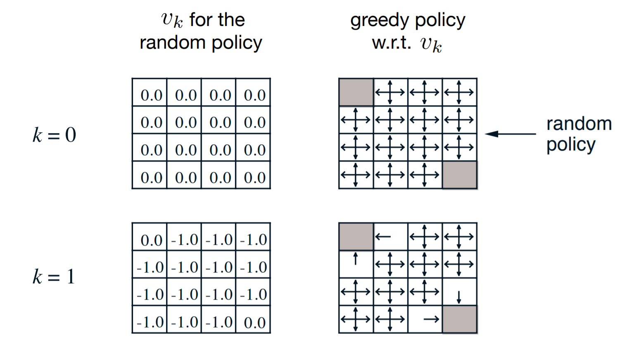
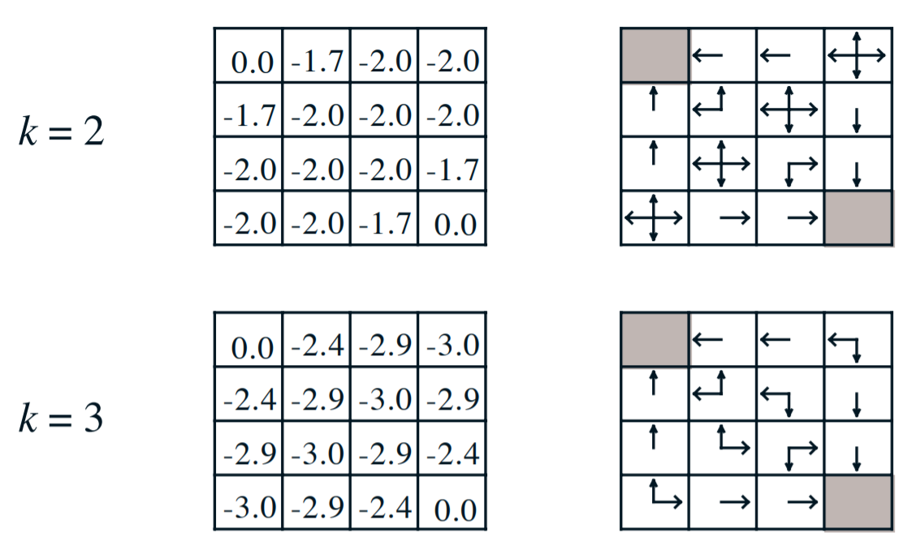
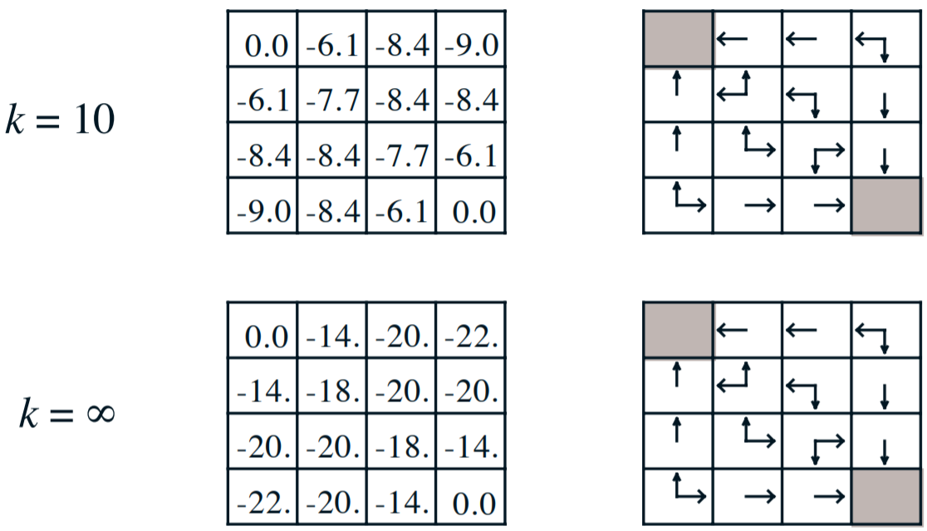
Dynamic Programming
Value Iteration Algorithm
Back to grid world algorithm: must we wait for exact convergence or can we stop algorithm earlier than that?

Slide 16
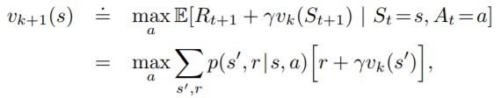
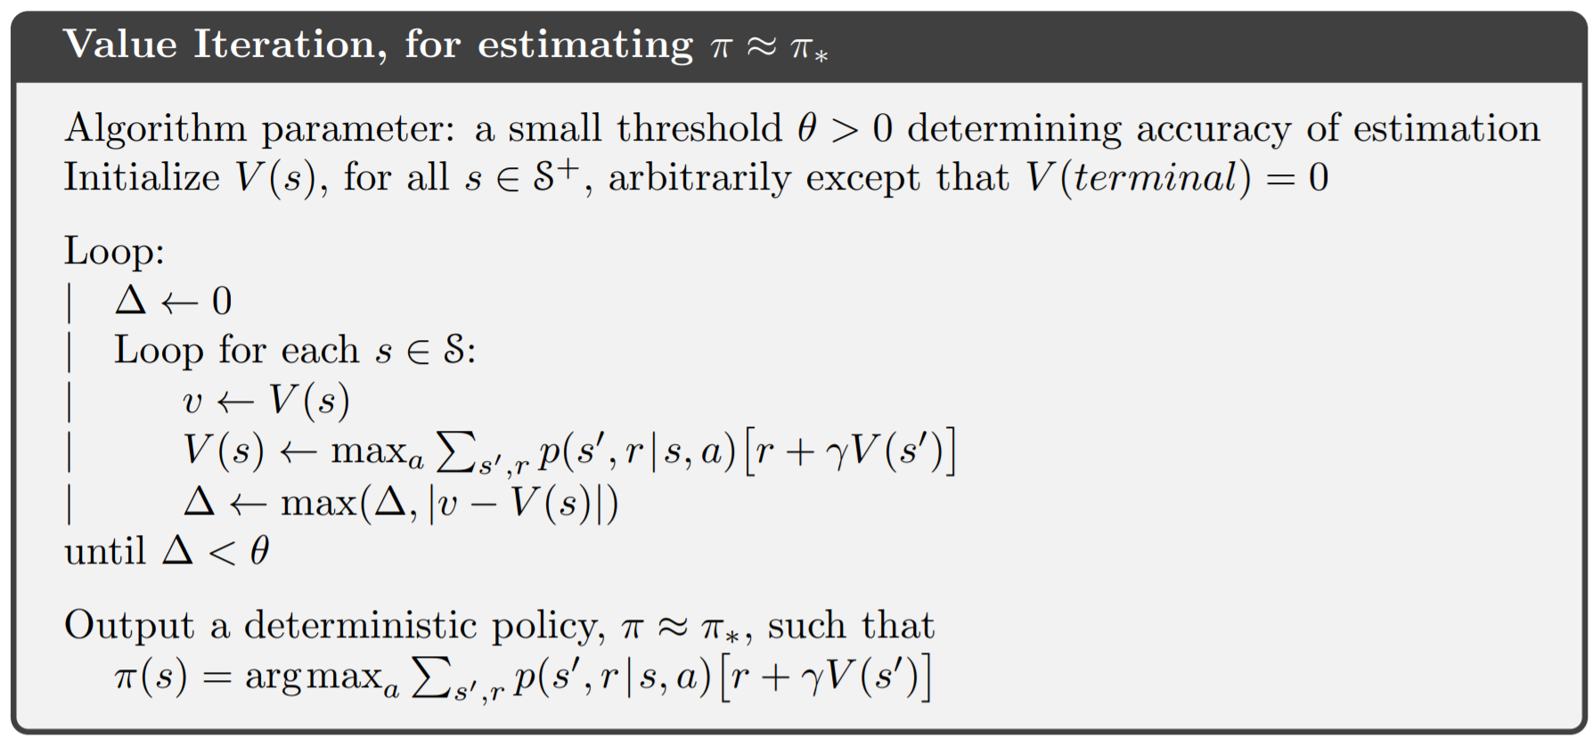
Dynamic Programming
Value Iteration Algorithm
In fact, policy iteration algorithm can be truncated in several ways!
From Policy Improvement
From Policy Evaluation
https://cs.stanford.edu/people/karpathy/reinforcejs/gridworld_dp.html

Slide 17










Dynamic Programming
Value Iteration
Gambler's problem:
If heads: gambler’s win as much as he staked
If tails: he loses his stake
Game ends when he reaches $100 or he runs out of money
100
0
S
S
(> 50)
$$p\left(heads\right)=0.4, r=+1$$
$$p=1, r=0$$
$$100−s$$
2 ∙ S - 100
$$p\left(tails\right)=0.6, r=0$$
S + 1
S
$$p\left(heads\right)=0.4, r=0$$
1
2 ∙ S
$$p\left(tails\right)=0.6, r=0$$
S - 1
S
(< 50)
$$p\left(heads\right)=0.4, r=0$$
…
…
$$p\left(tails\right)=0.6, r=0$$
0
All win (s)
$$min⁡(s, 100−s)$$

Slide 18
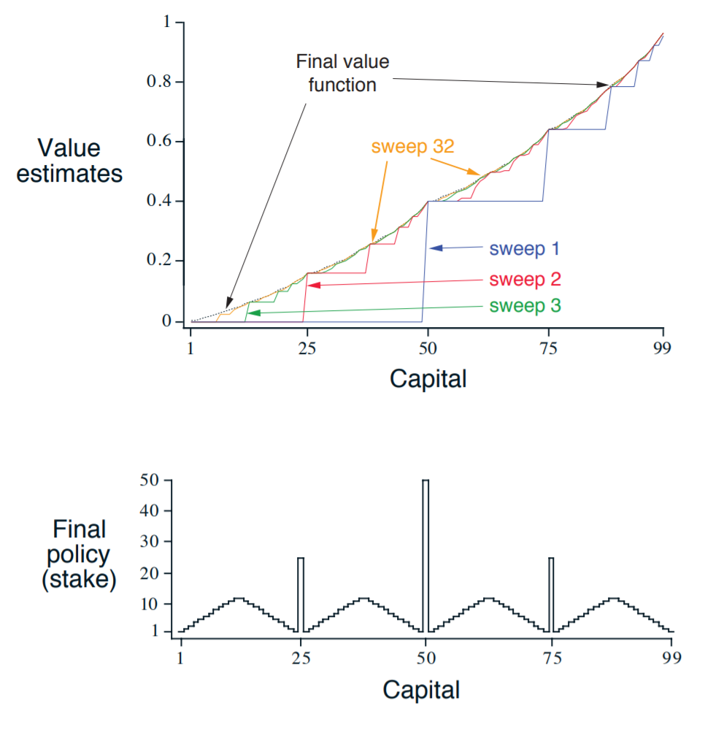

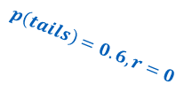


Dynamic Programming
Value Iteration
Gambler's problem:
Why such curious form?
51
$$p\left(heads\right)=0.4, r=0$$
1
49
$$p\left(tails\right)=0.6, r=0$$
50
…
50
100
$$p\left(heads\right)=0.4, r=+1$$
$$p\left(tails\right)=0.6, r=0$$
0

Slide 19




Dynamic Programming
Value Iteration
Gambler's problem:
Why such curious form?
$$q\left(s=50, a=1\right)$$
$$=.4∙v\left(49\right)+ .6∙v\left(51\right)$$
$$\text{=.3923}$$
$$q\left(s=50, a=50\right)$$
$$=.4∙v\left(100\right)+ .6∙v\left(0\right)$$
$$\text{=.}\text{4}$$
$$q\left(s=51, a=49\right)$$
$$=.4∙v\left(100\right)+ .6∙v\left(2\right)$$
$$\text{=.}\text{4031}$$
$$q\left(s=51, a=1\right)$$
$$=.4∙v\left(52\right)+ .6∙v\left(50\right)$$
$$\text{=.}\text{4031}$$
Ties!
(are arbitrarily broken with the first index)

Slide 20
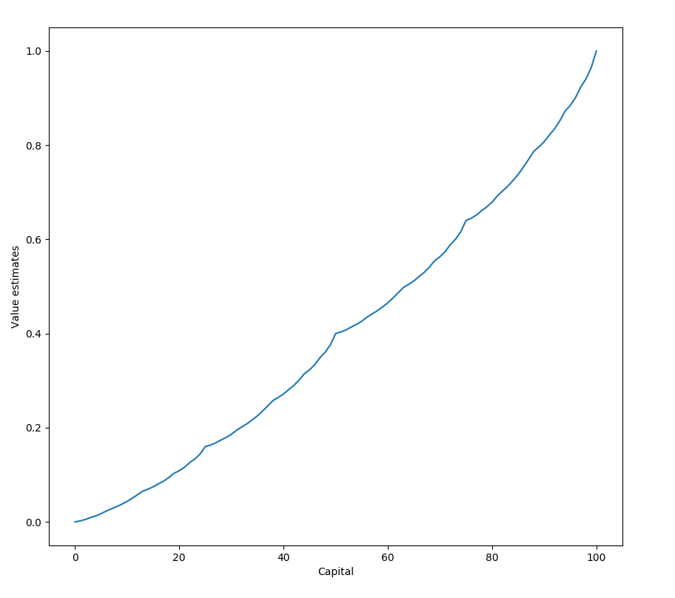
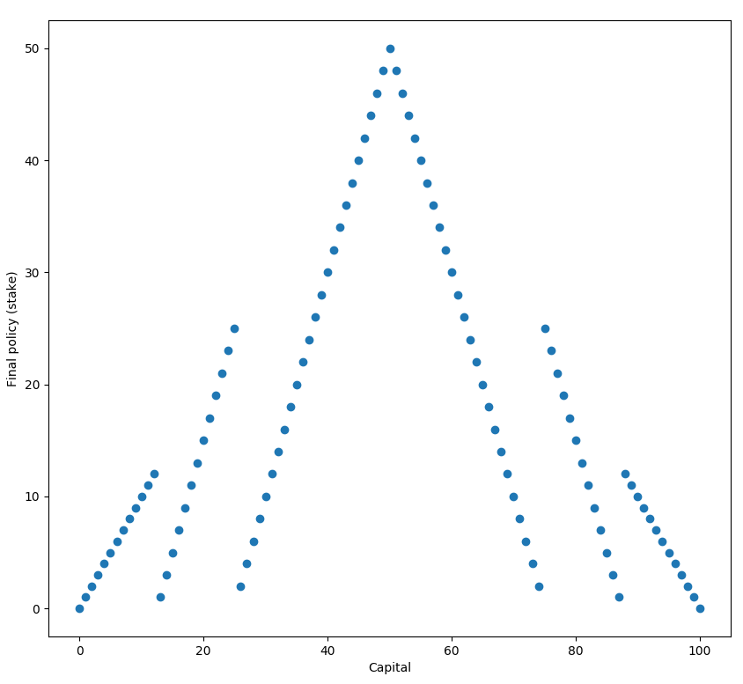
Dynamic Programming
Value Iteration
Gambler's problem:
What if ties are broken with the last index?

Slide 21
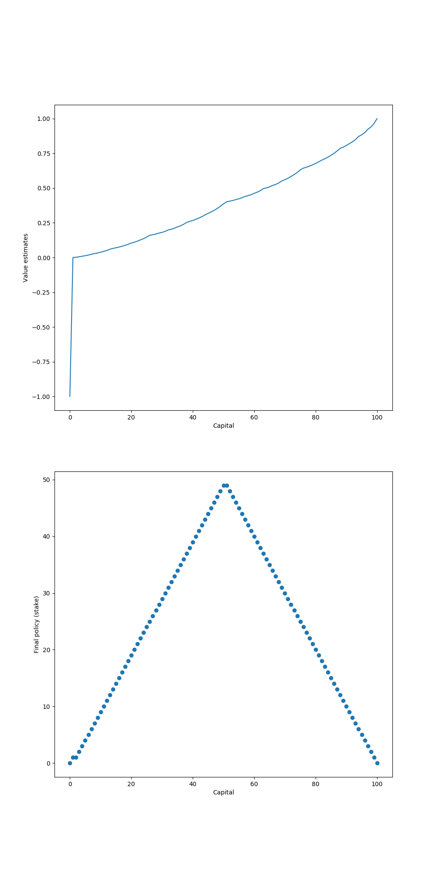


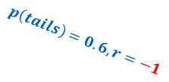

Dynamic Programming
Value Iteration
Gambler's problem:
Why such curious form?
51
$$p\left(heads\right)=0.4, r=0$$
1
49
$$p\left(tails\right)=0.6, r=0$$
50
…
50
100
$$p\left(heads\right)=0.4, r=+1$$
$$p\left(tails\right)=0.6, r=−1$$
0

Slide 22
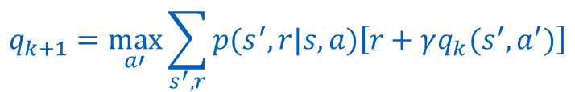
Dynamic Programming
Value Iteration
Which is the analog of the value iteration update for action values, eq. q_{k+1}?
Hint:
$$q_{k+1}=\max_{a′}{\sum_{s^{′}, r}{p(s^{′}, r|s,a)\left[r+γq_{k}(s^{′},a^{′})\right]}}$$

Slide 23
Dynamic Programming
Drawbacks
If the state space is large, a single sweep can be prohibitively expensive (backgammon 10²⁰ states) -> Asynchronous Dynamic Programming
Transition probabilities must be known by the system -> world model -> model-free RL

Slide 24
Thank you!
amadeus.com Amadeus.com/blog
You can follow us on:
AmadeusITgroup
Notes:
Backcover option 1

